Slide 1
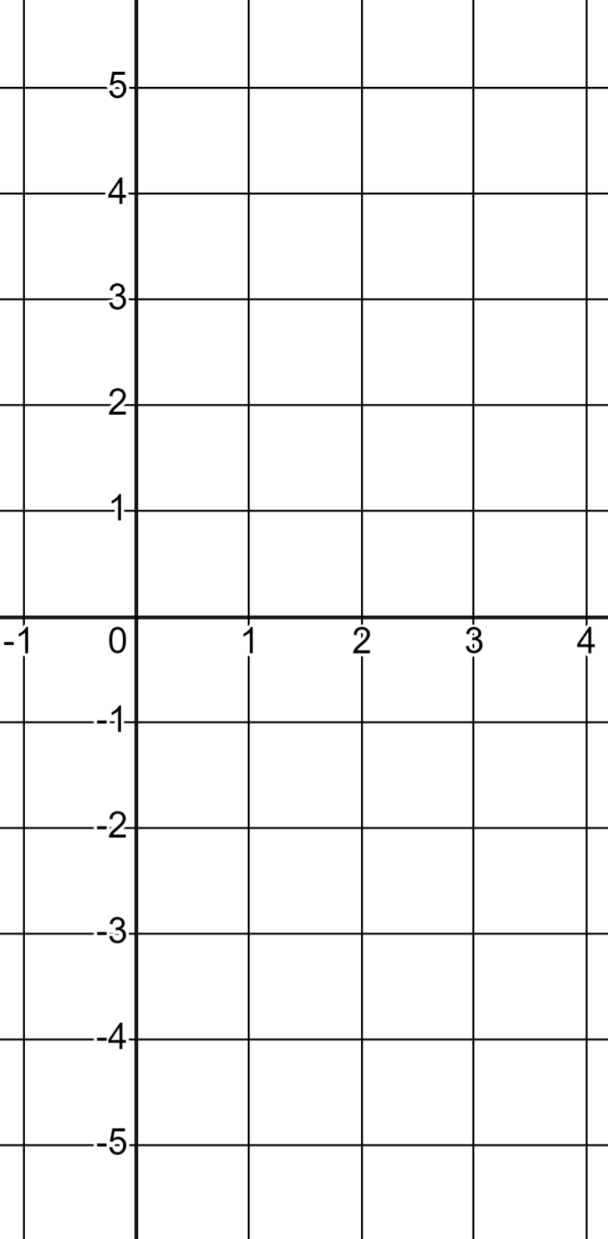
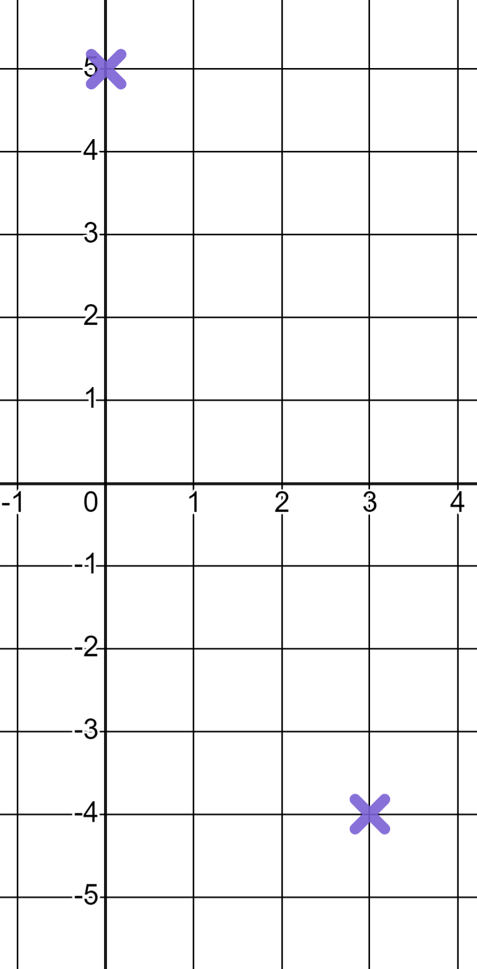
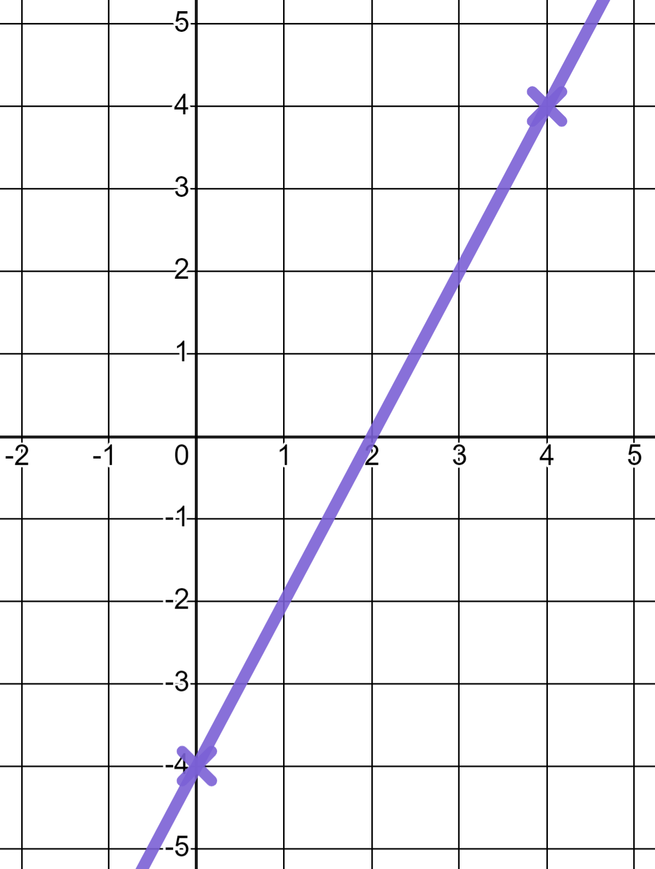
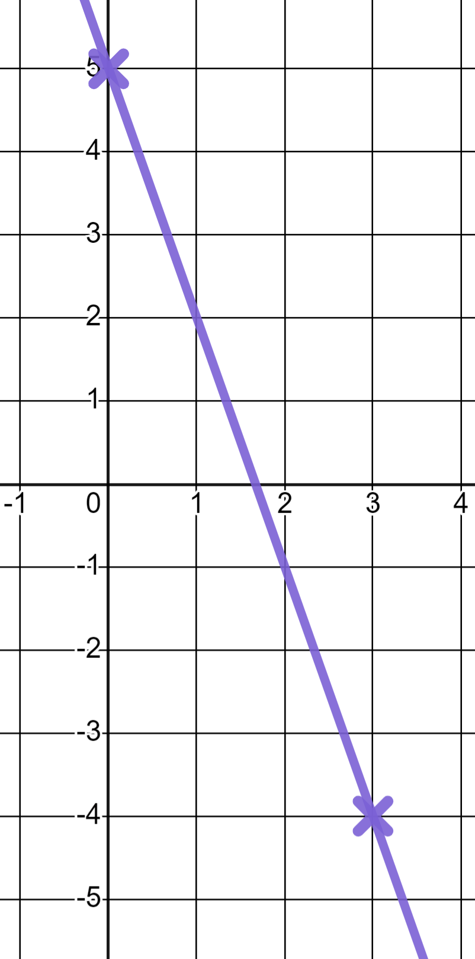
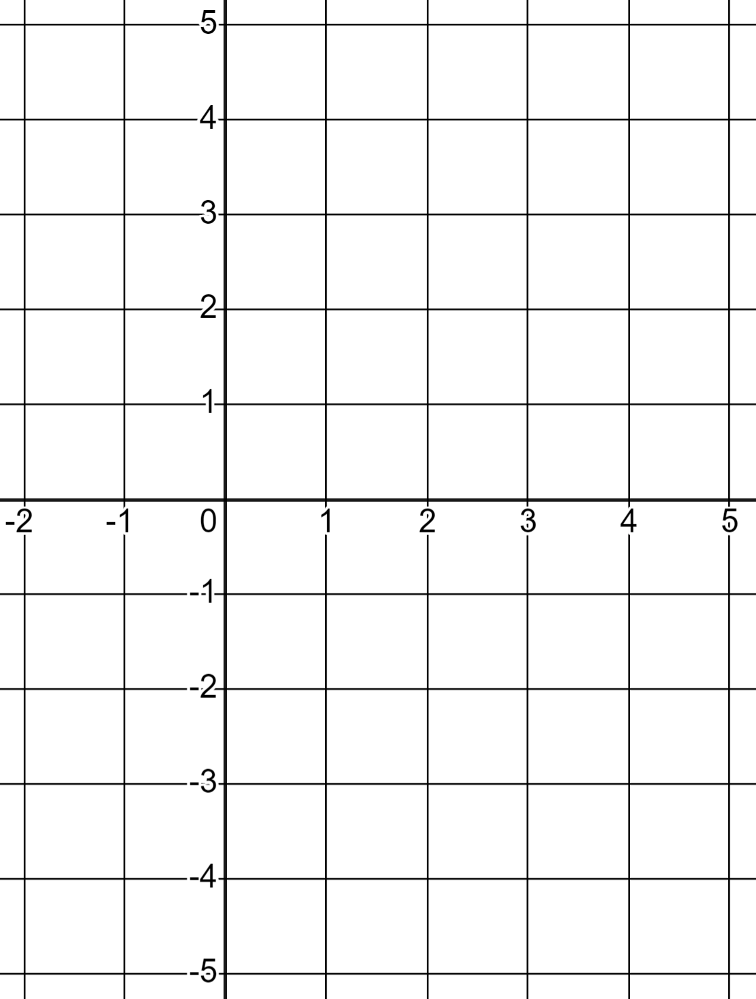
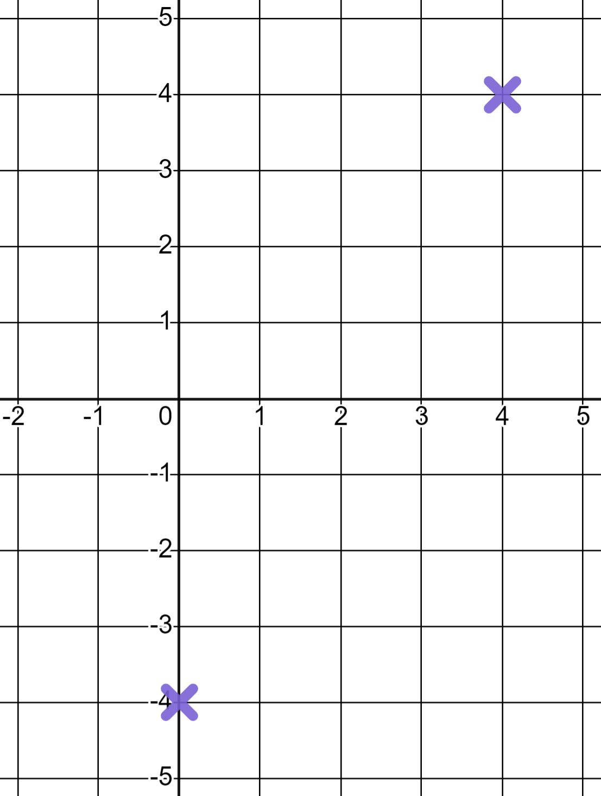
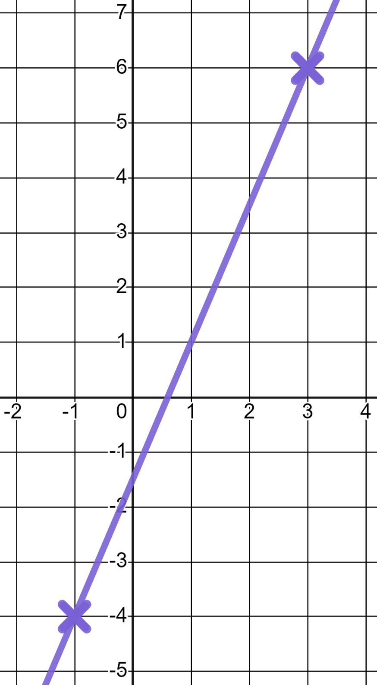
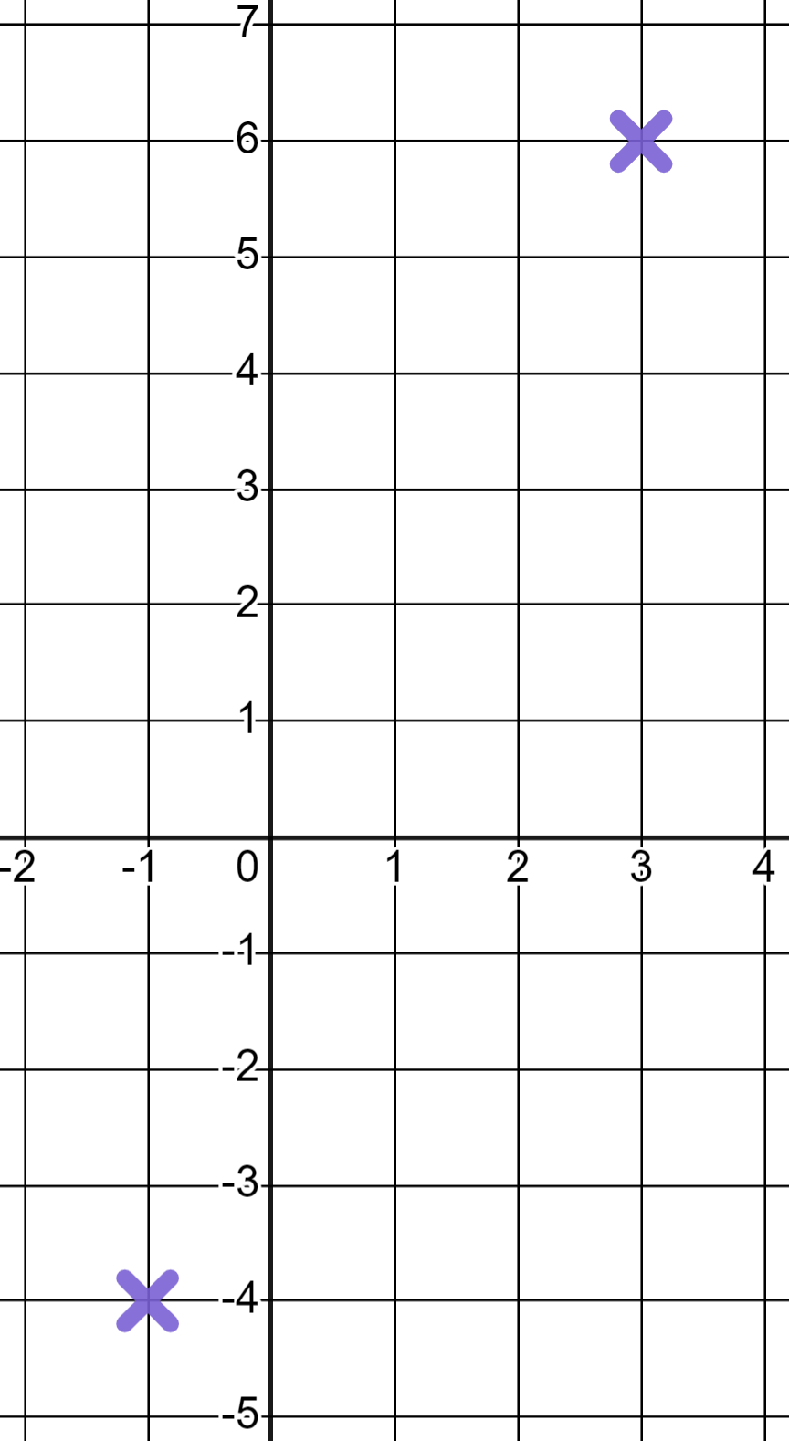
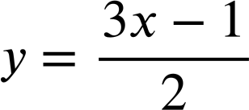
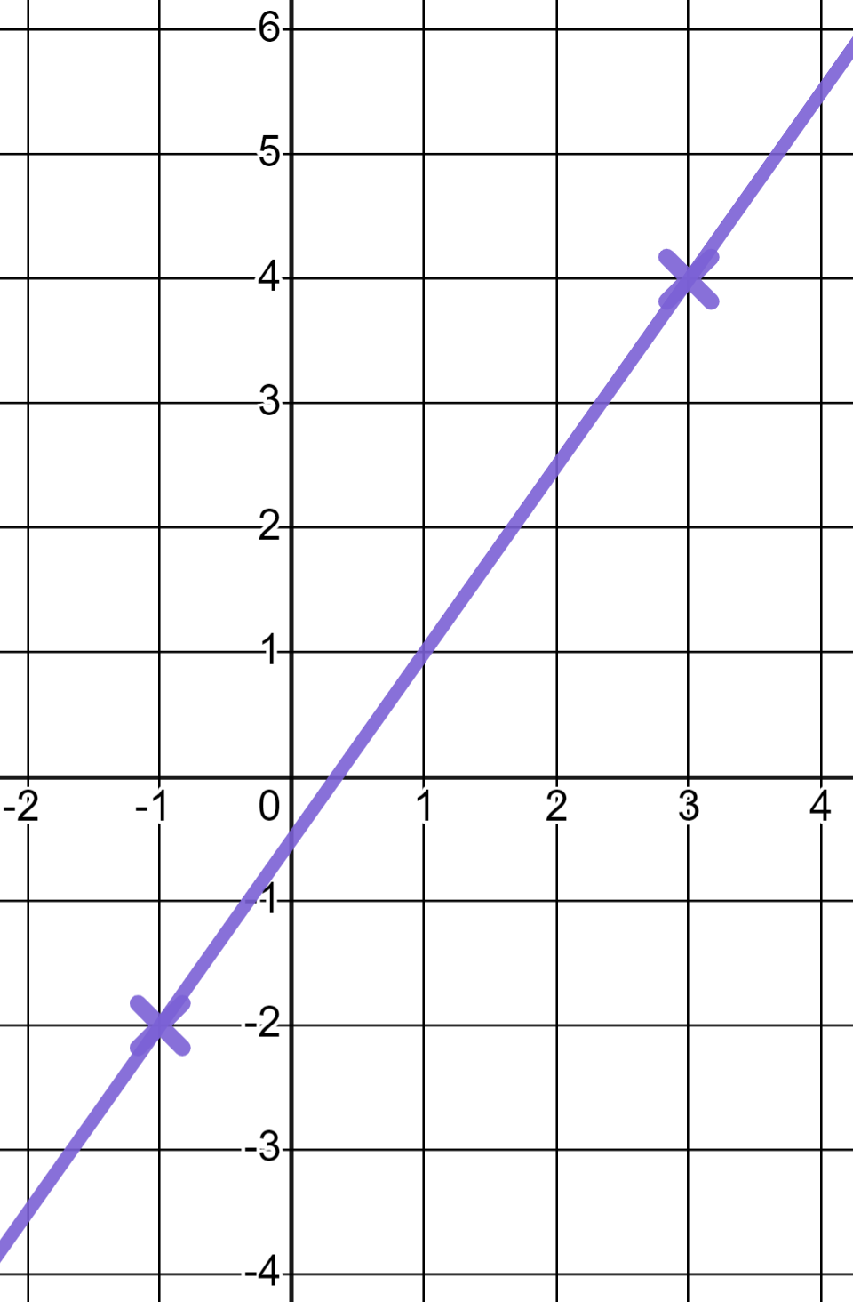
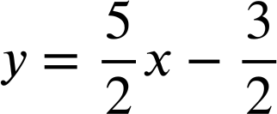
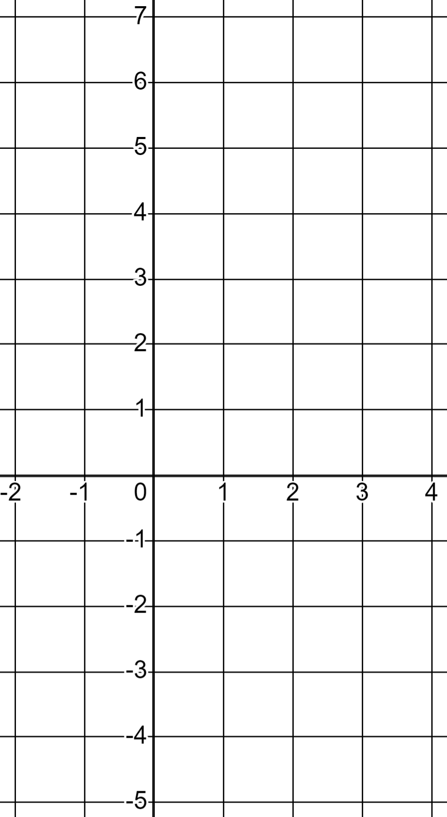
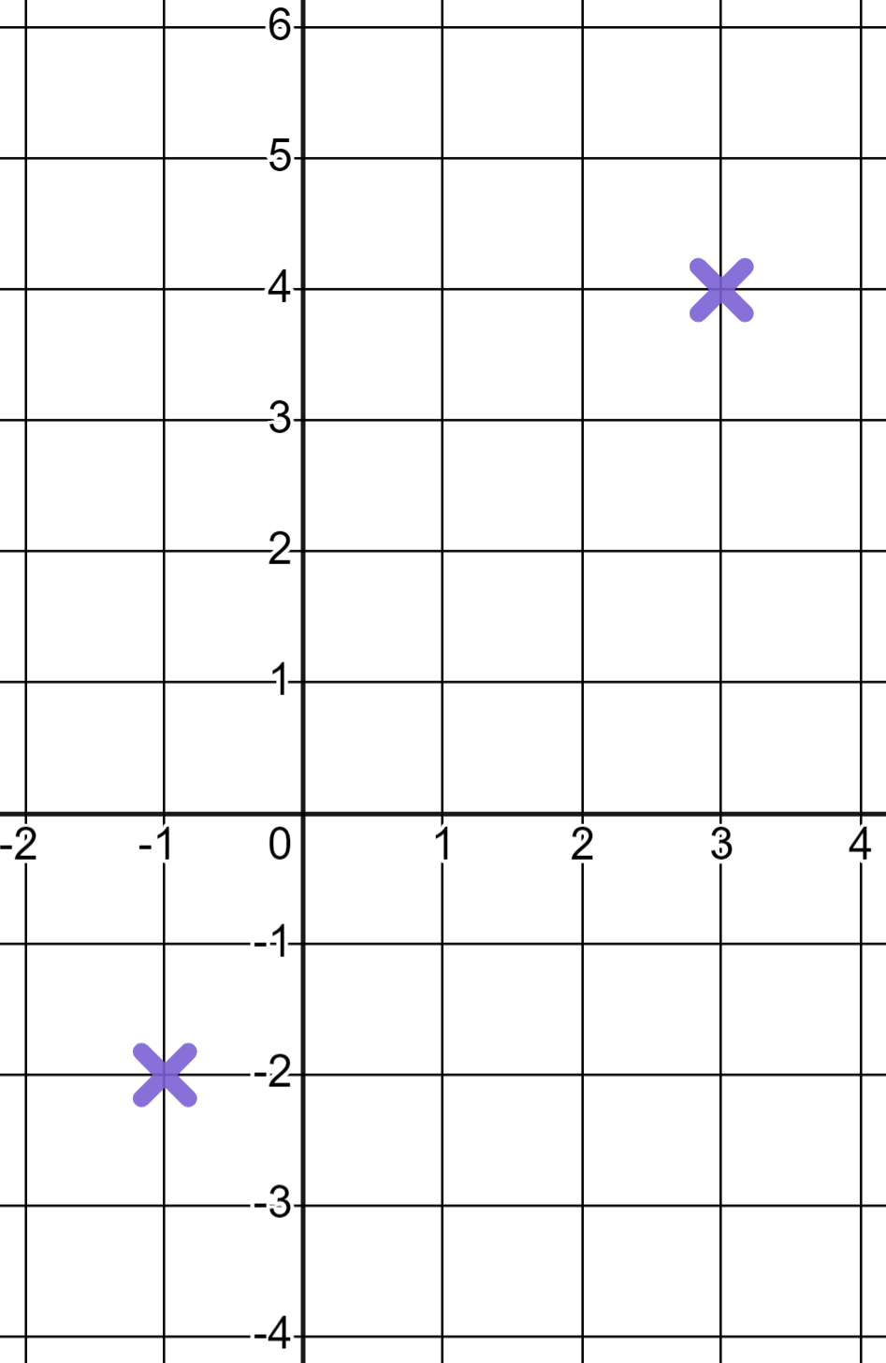
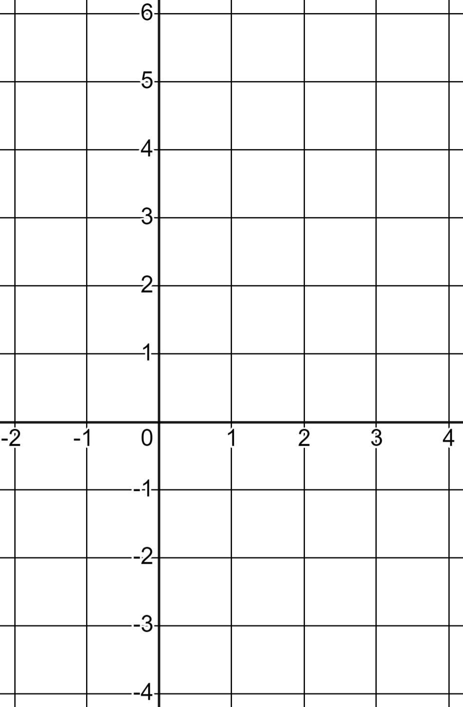
Efficiently drawing linear graphs
Task A: Plotting linear graphs
1) In each case fill in the missing coordinate and draw the respective linear graph.
a) y = 2x − 4
b) y = 5 − 3x
(0, -4 )
(0, 5 )
(4, 4 )
(3, -4 )
c)
d)
(−1, -2 )
(−1, -4 )
(3, 4 )
(3, 6 )

Slide 2
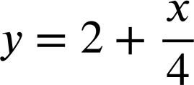
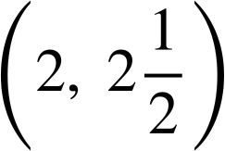
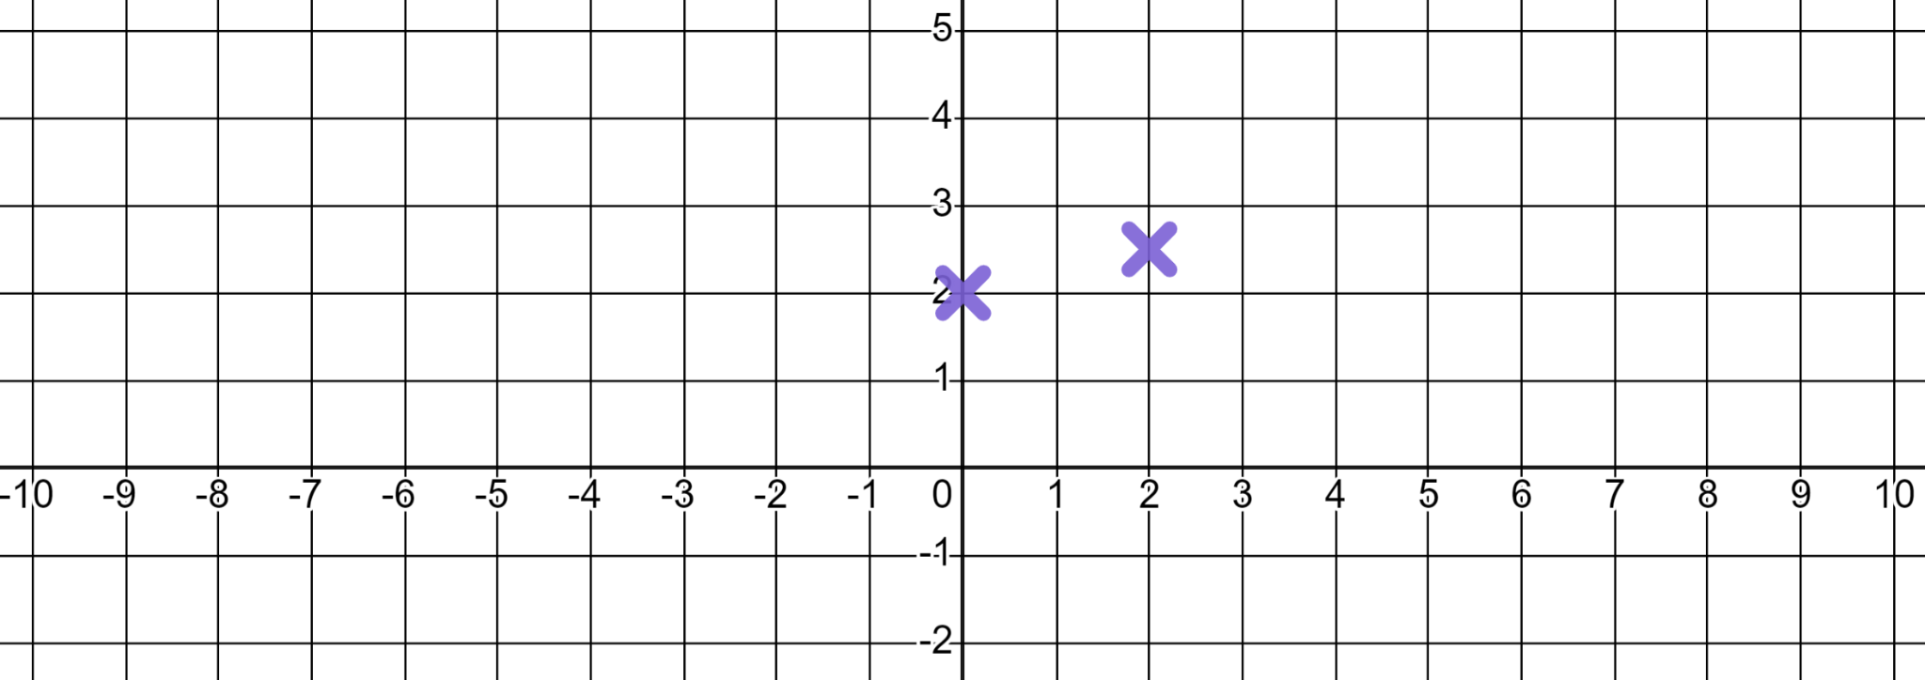

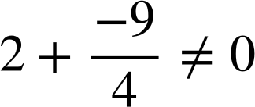
Efficiently drawing linear graphs
2) Alex plots the linear graph of using these two coordinates.
(0, 2)
(−9, 0)
✖
Use the coordinate (−9, 0) to demonstrate that they are wrong and write a sentence advising what they might do better.
so (−9, 0) can not be a coordinate on the line
You might have written:
“Start with two more distant coordinates to increase accuracy”

Slide 3
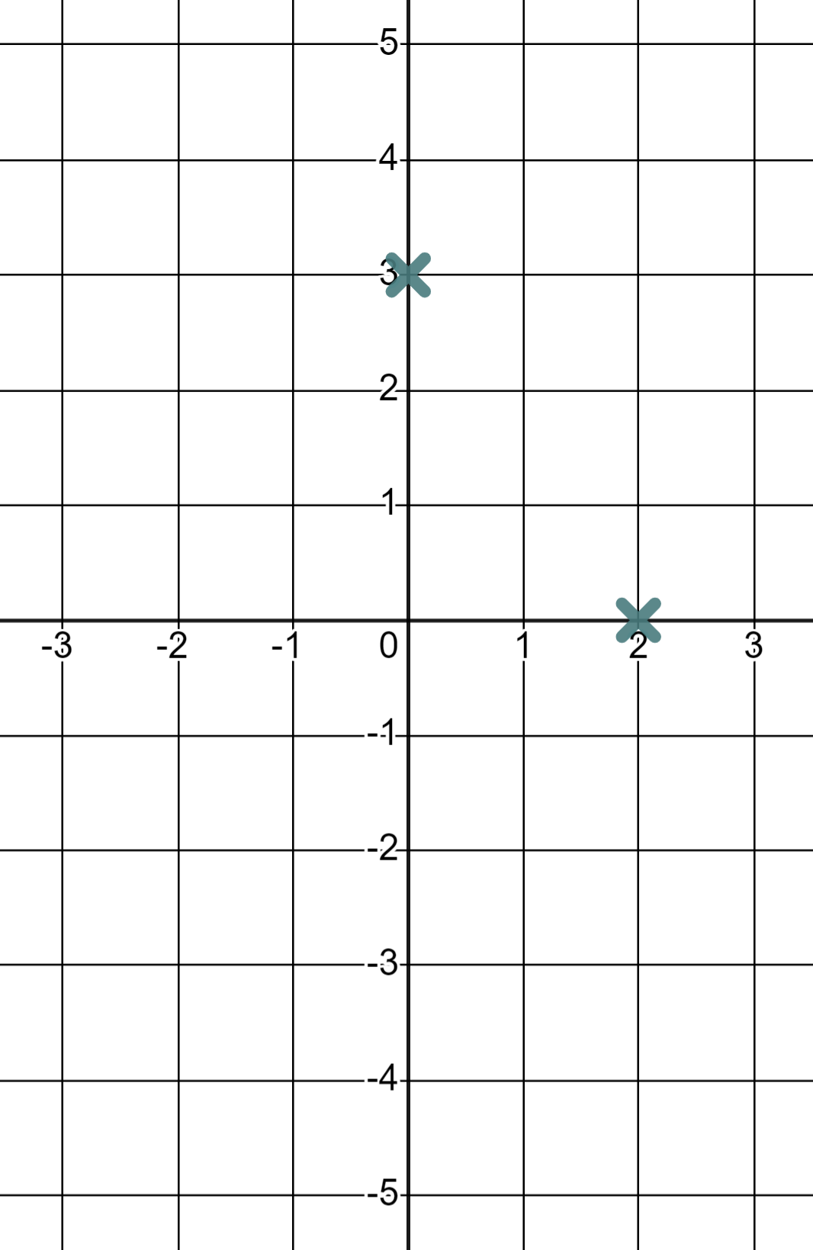
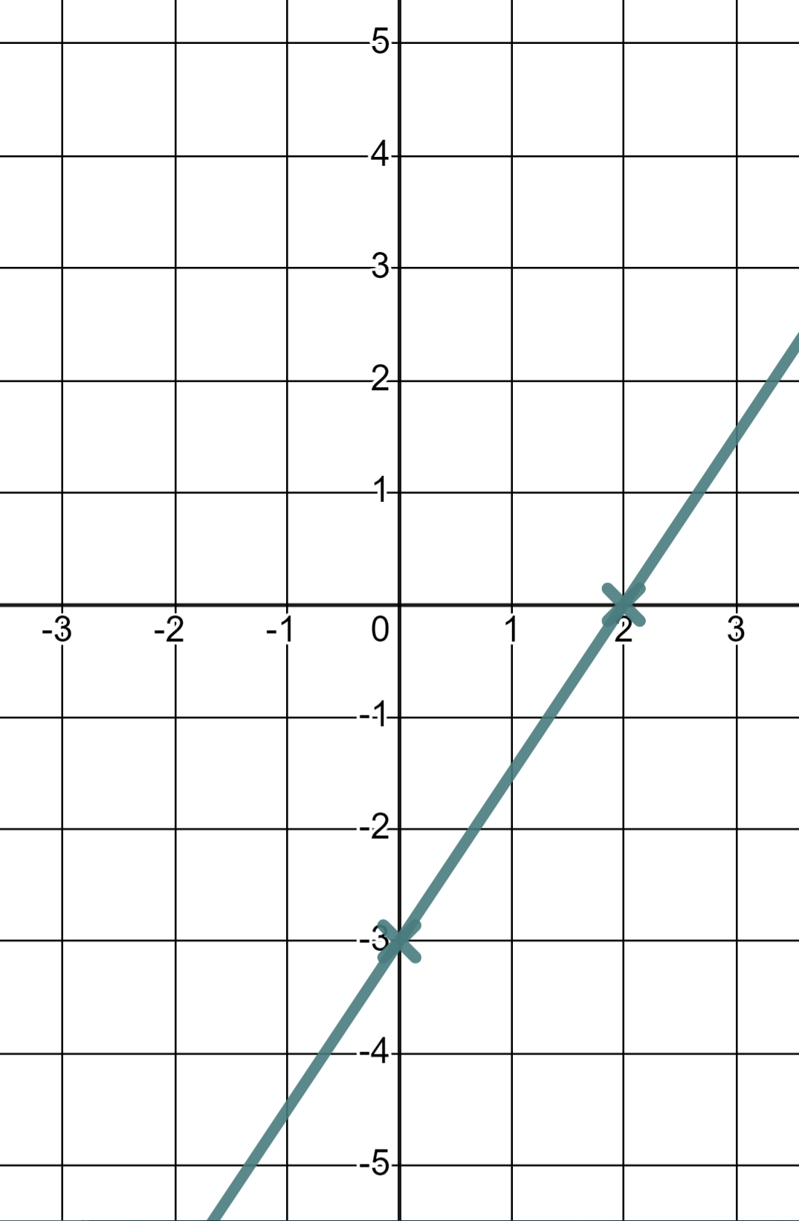
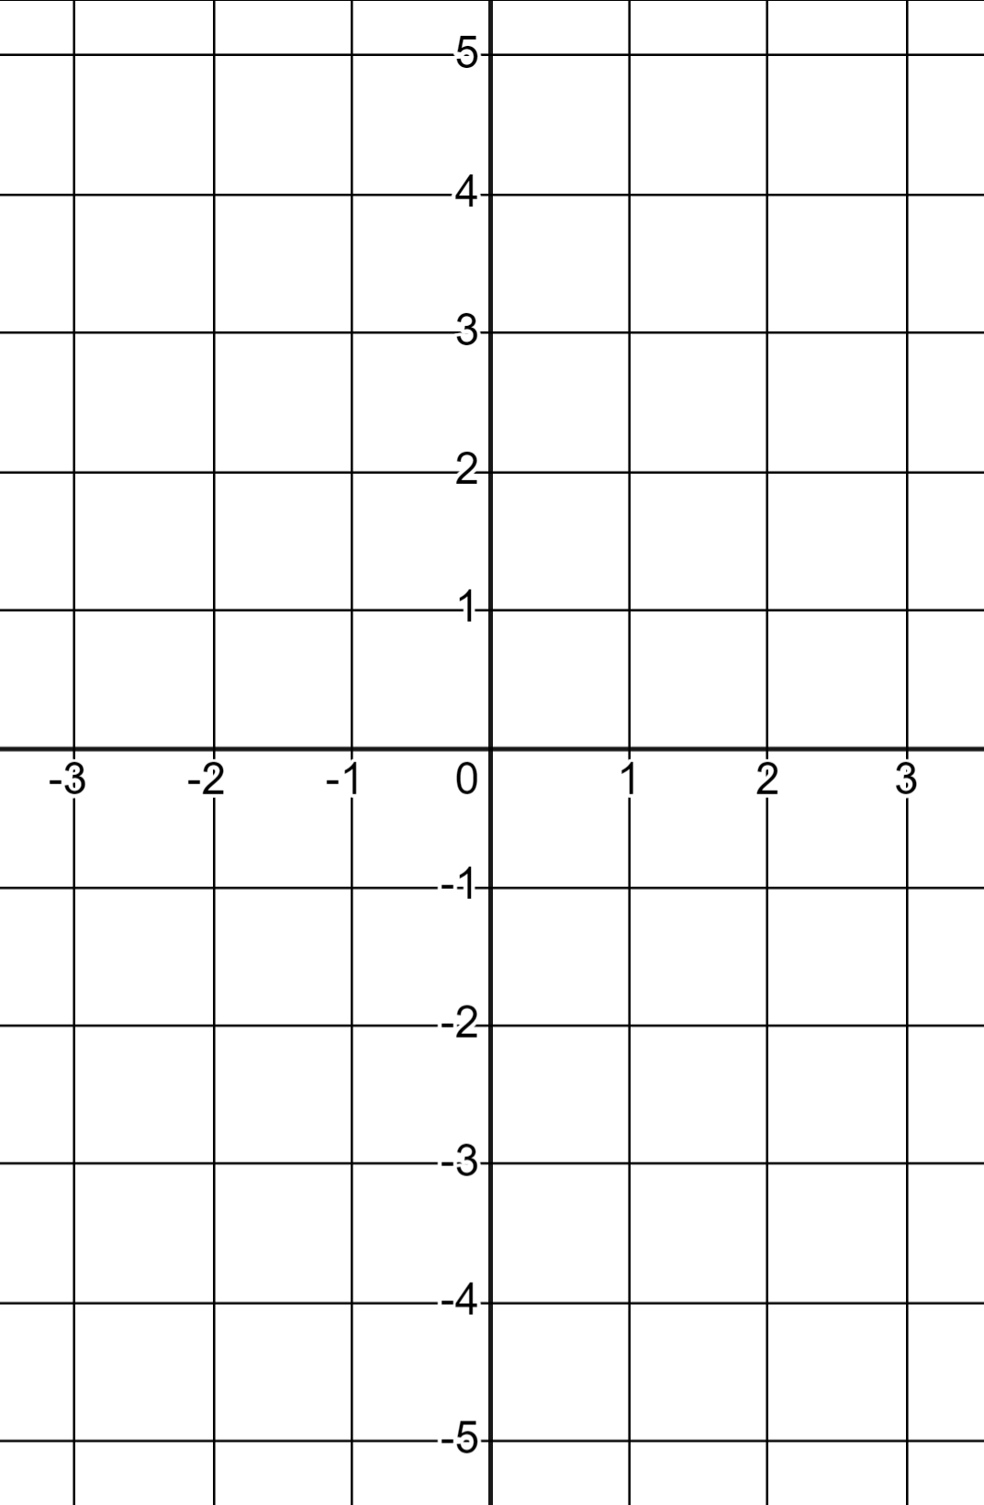
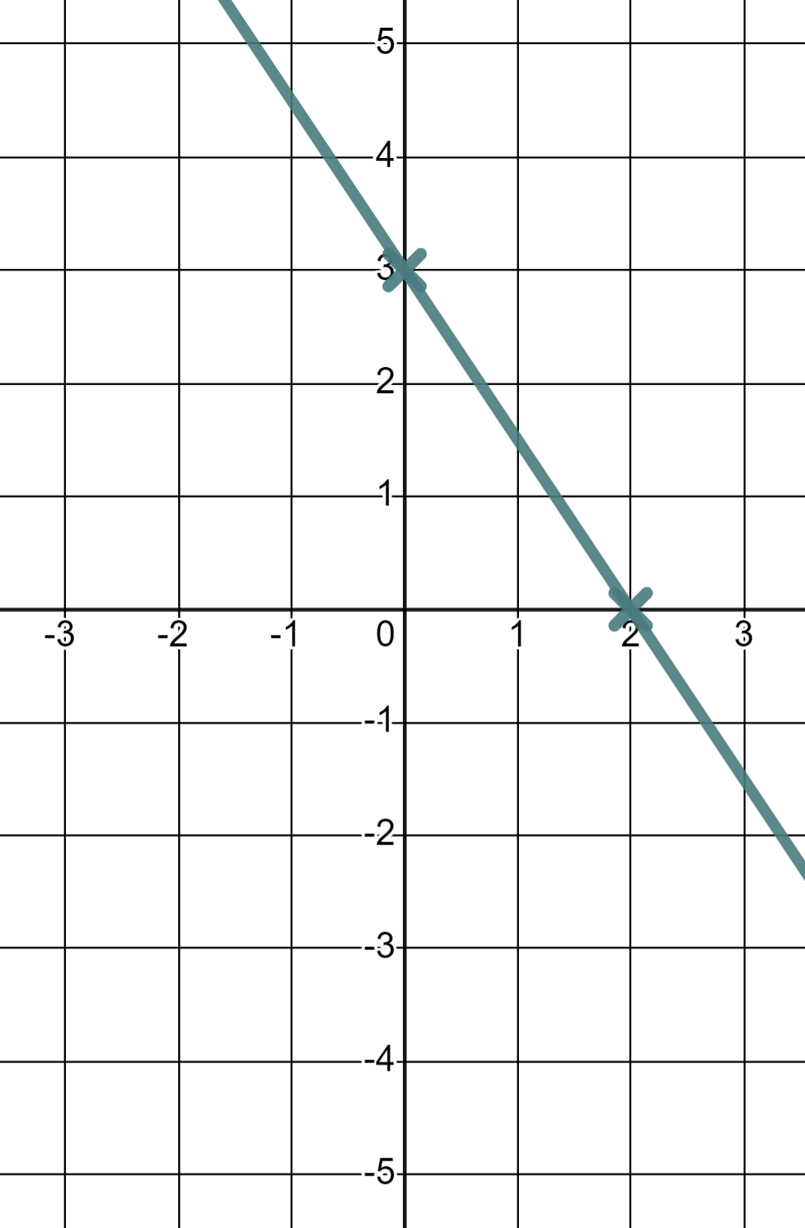
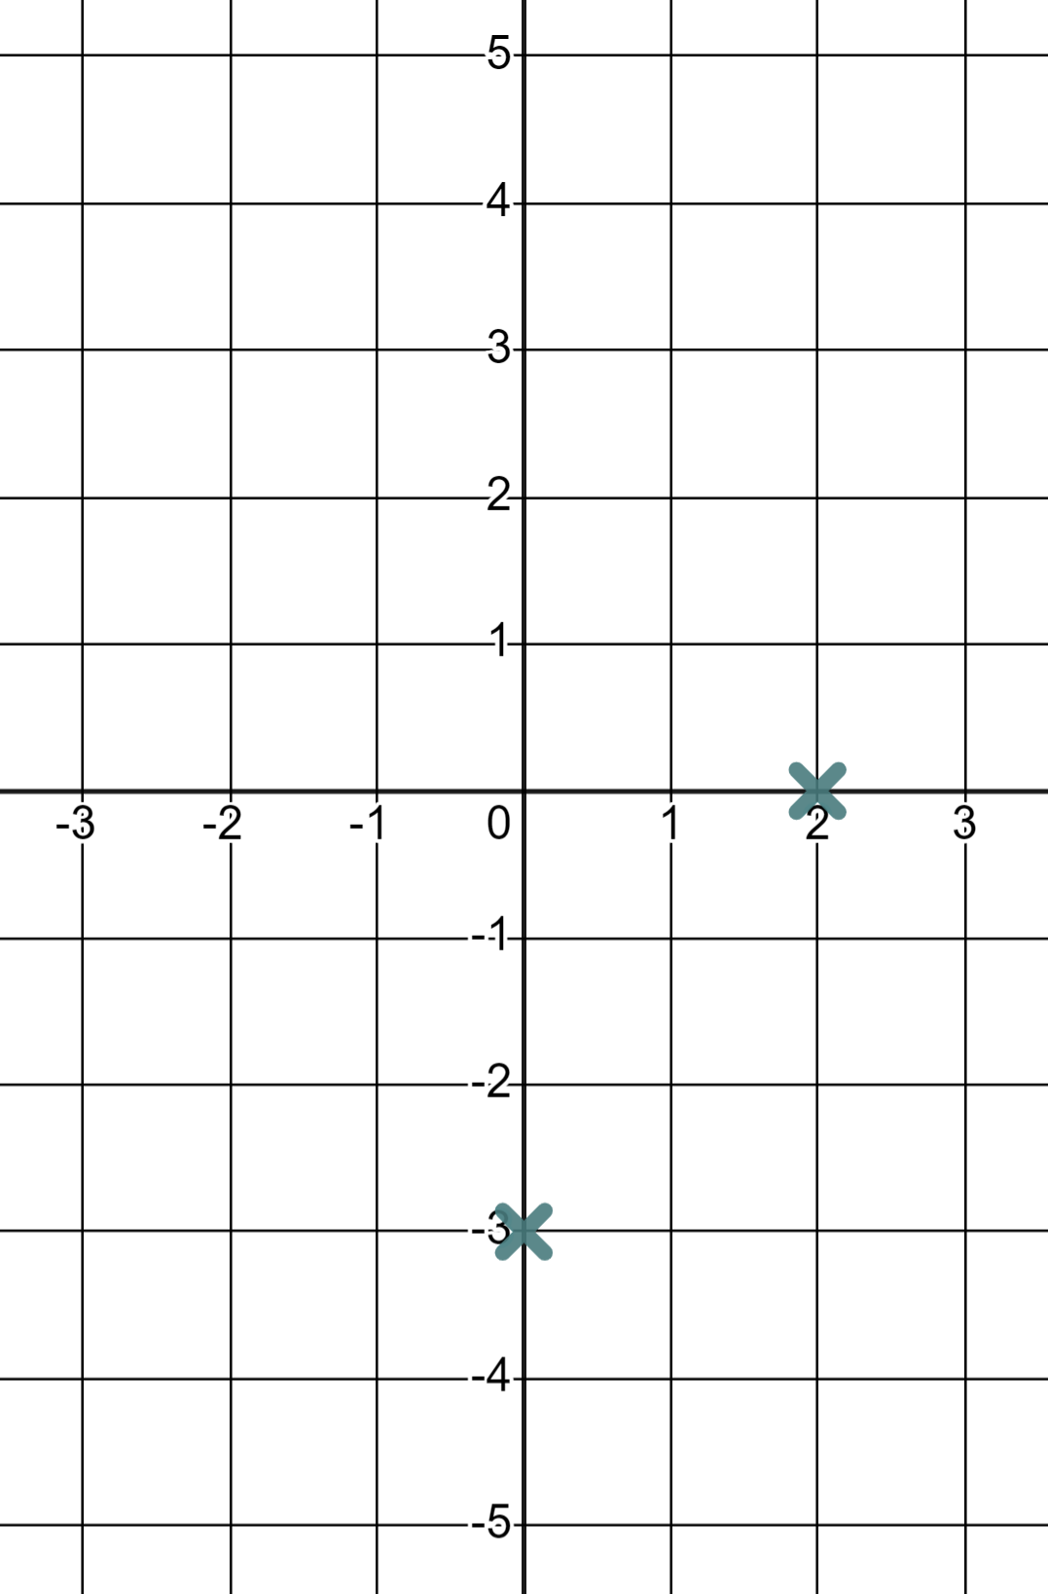
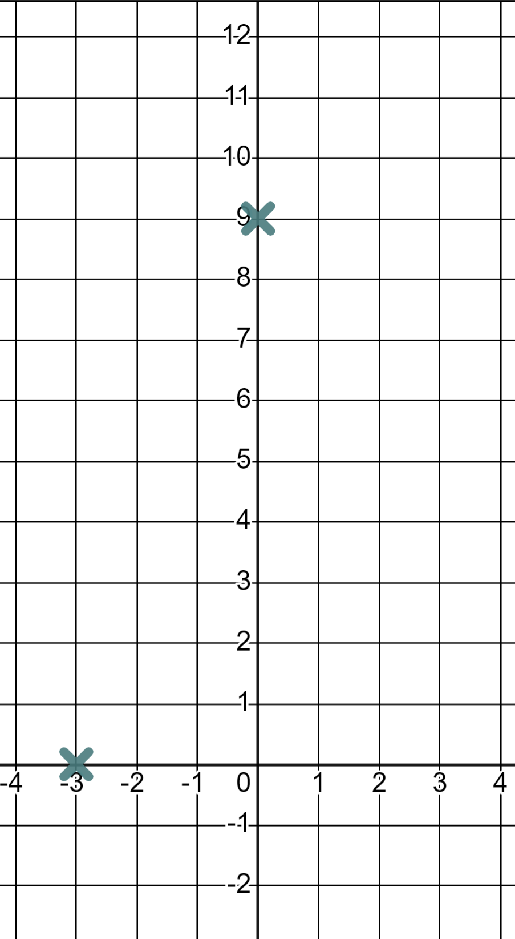
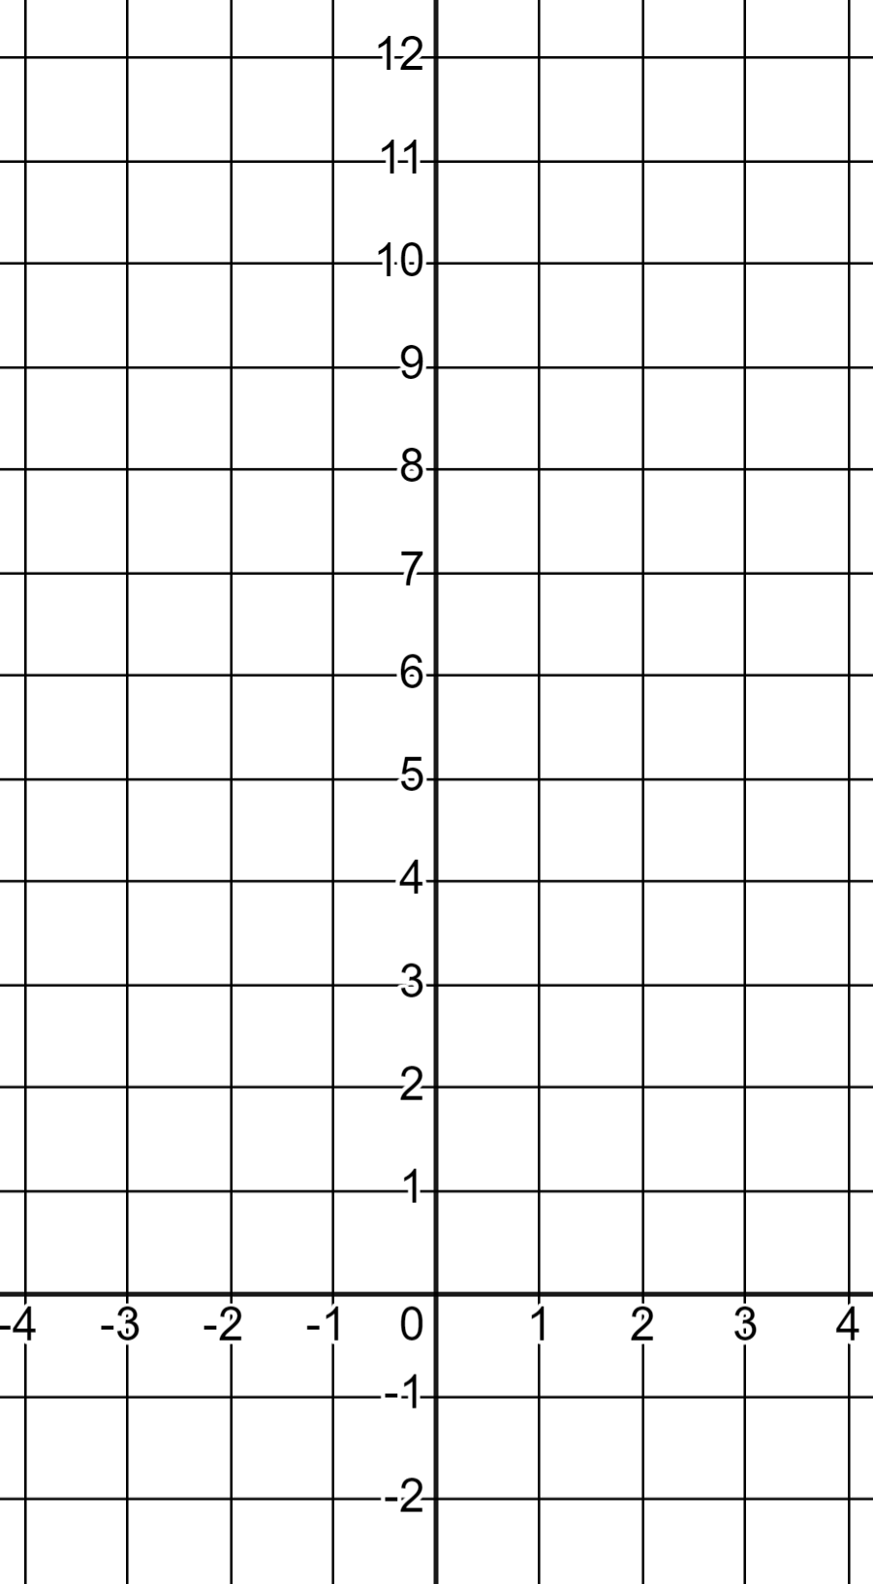
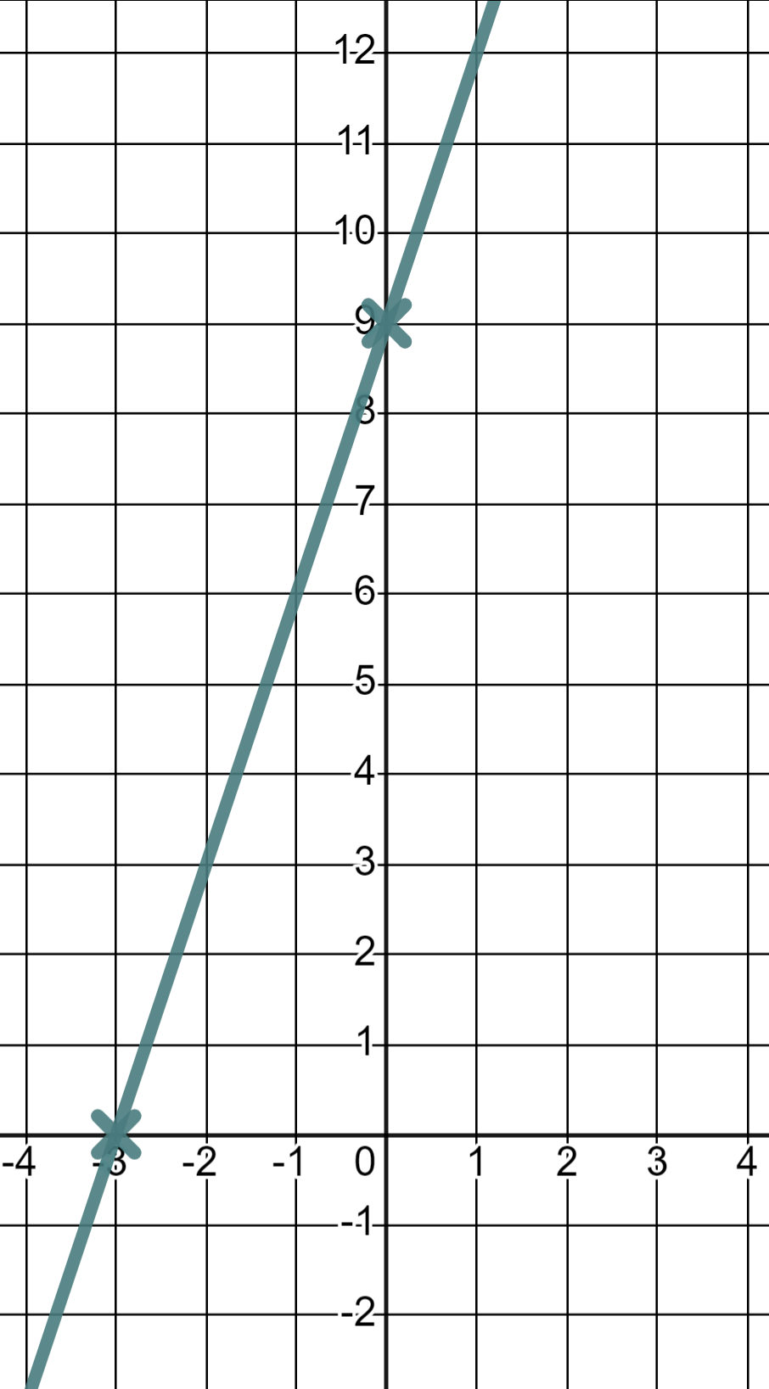
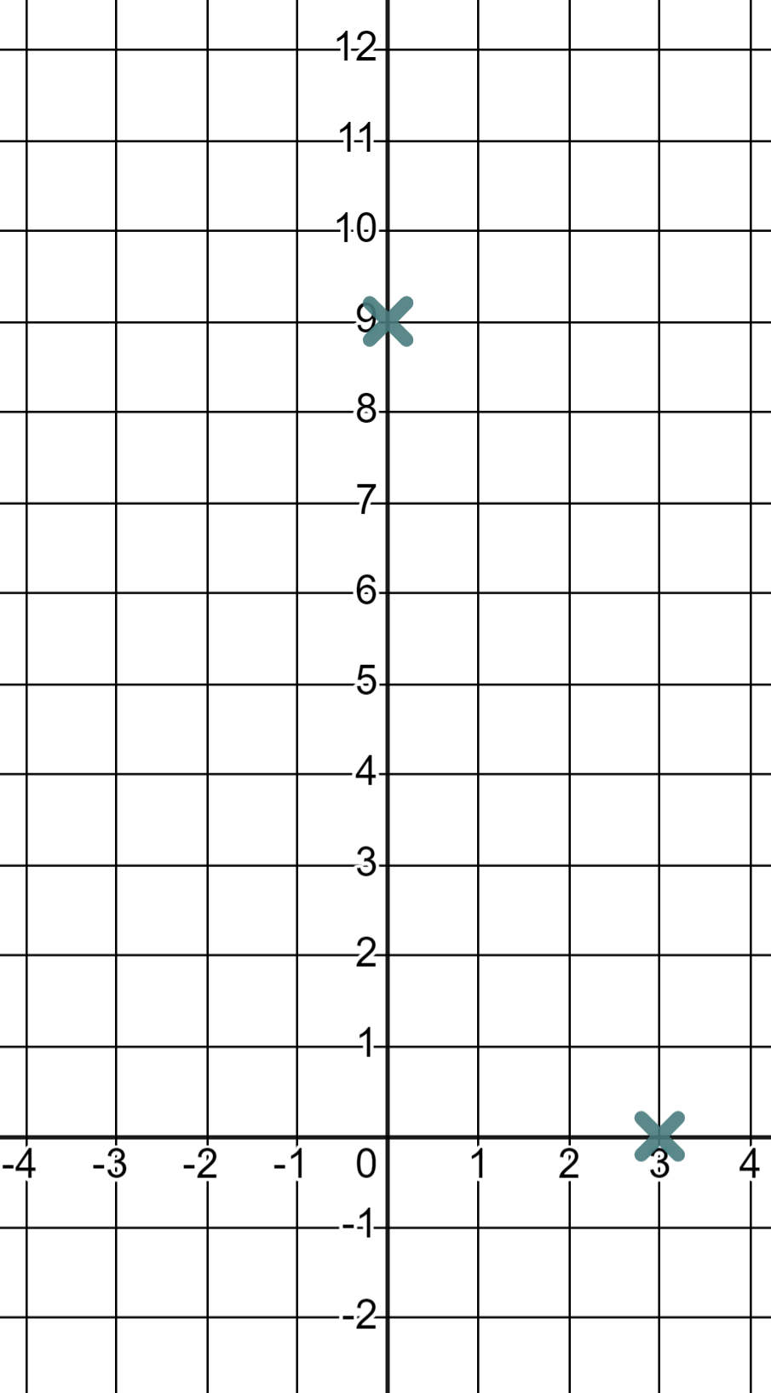
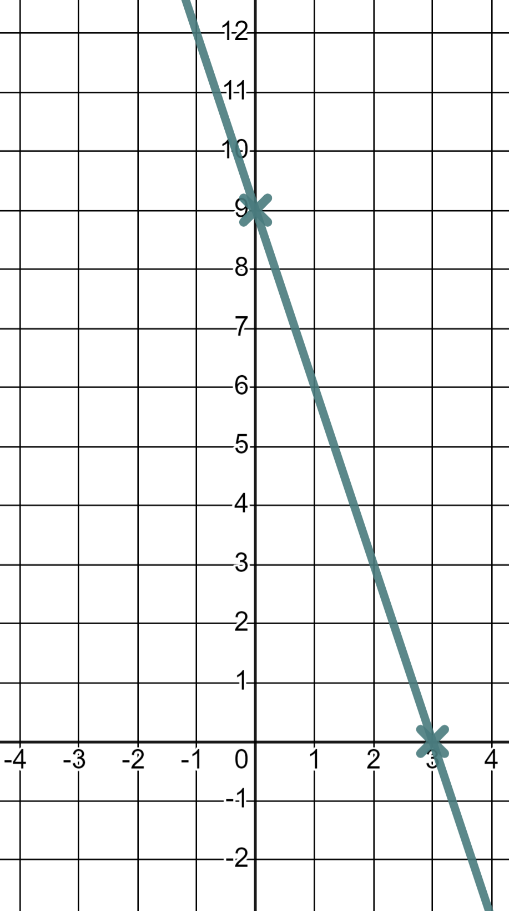
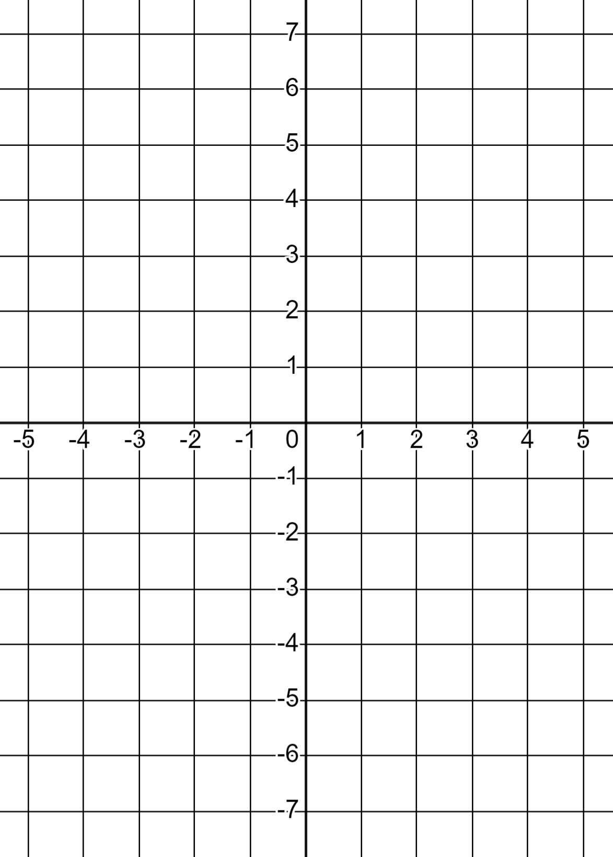
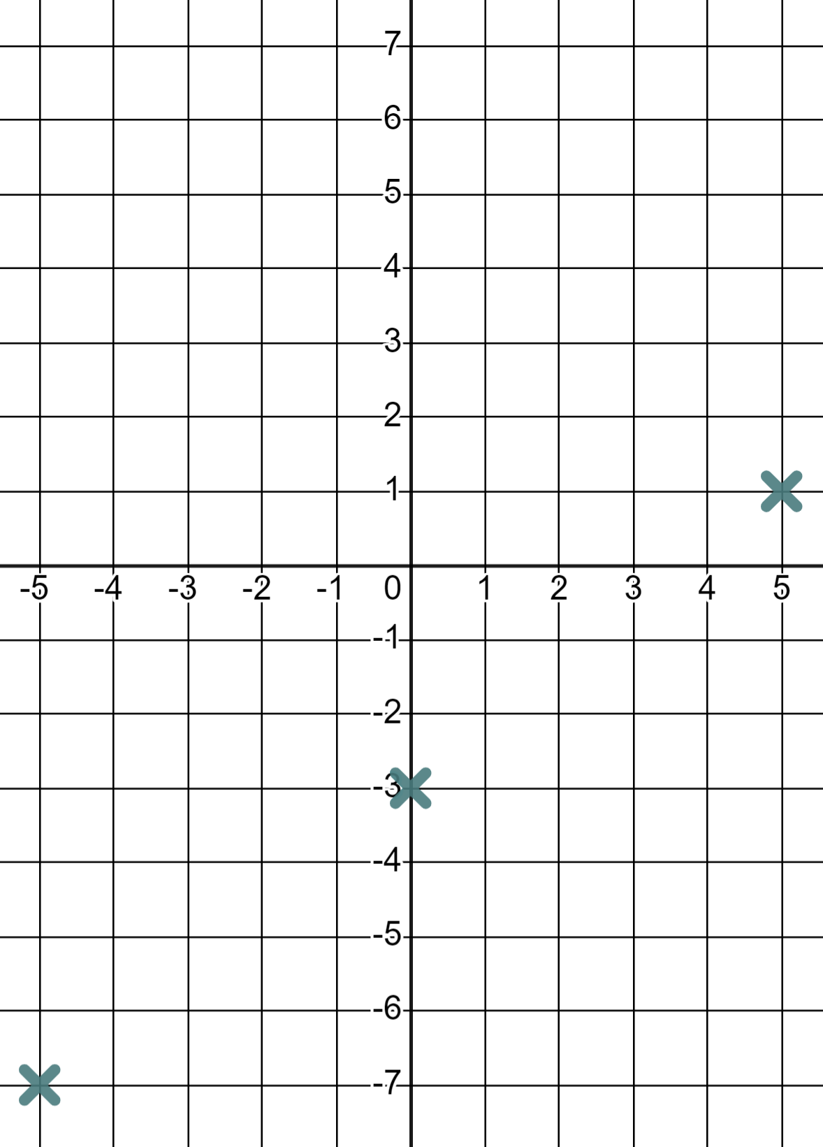
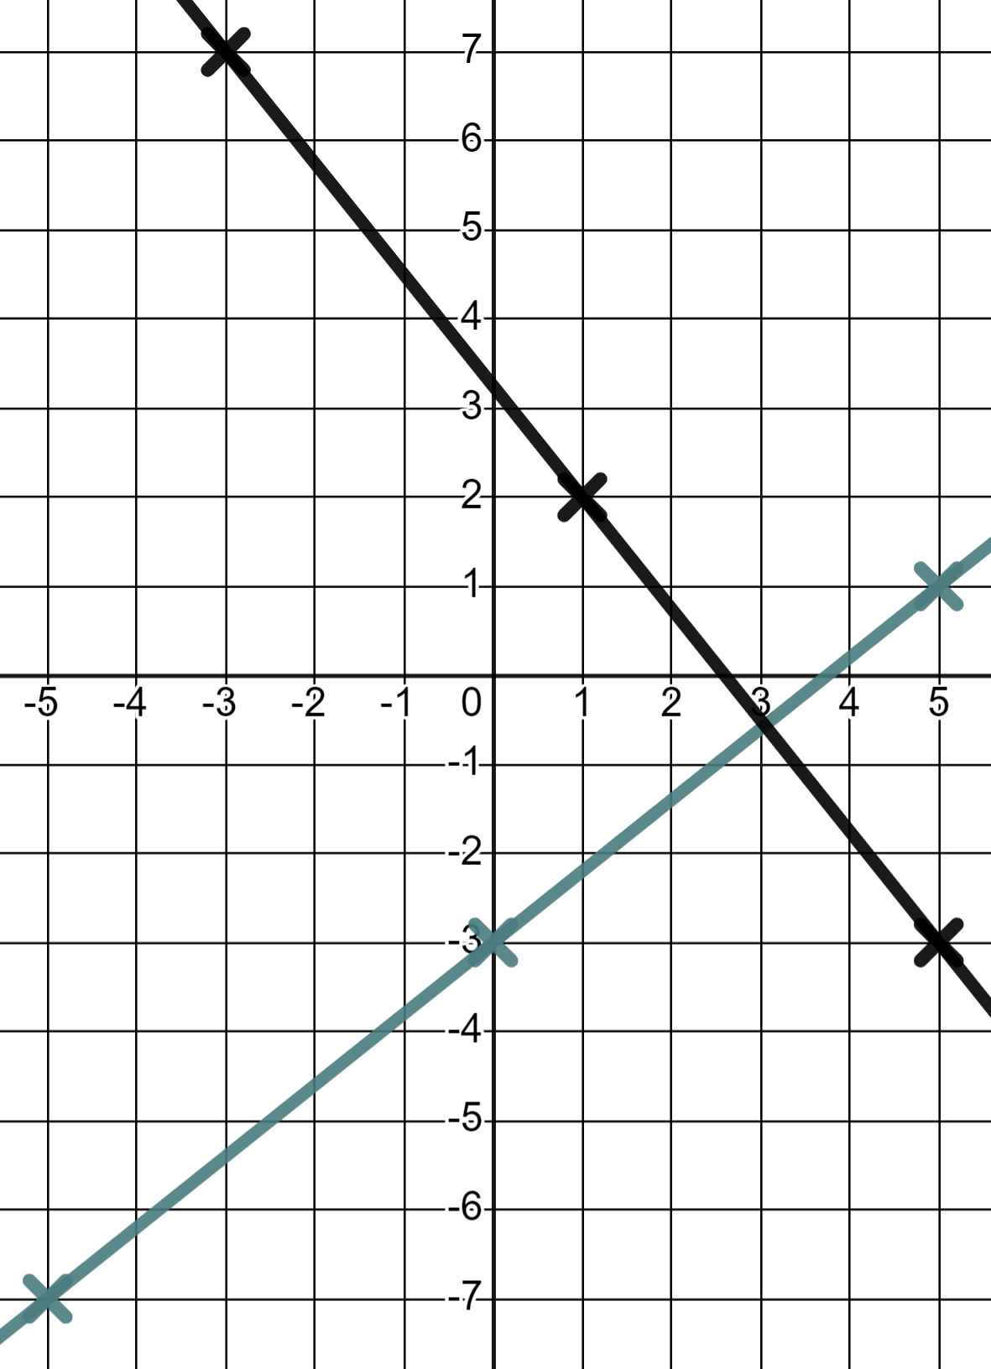
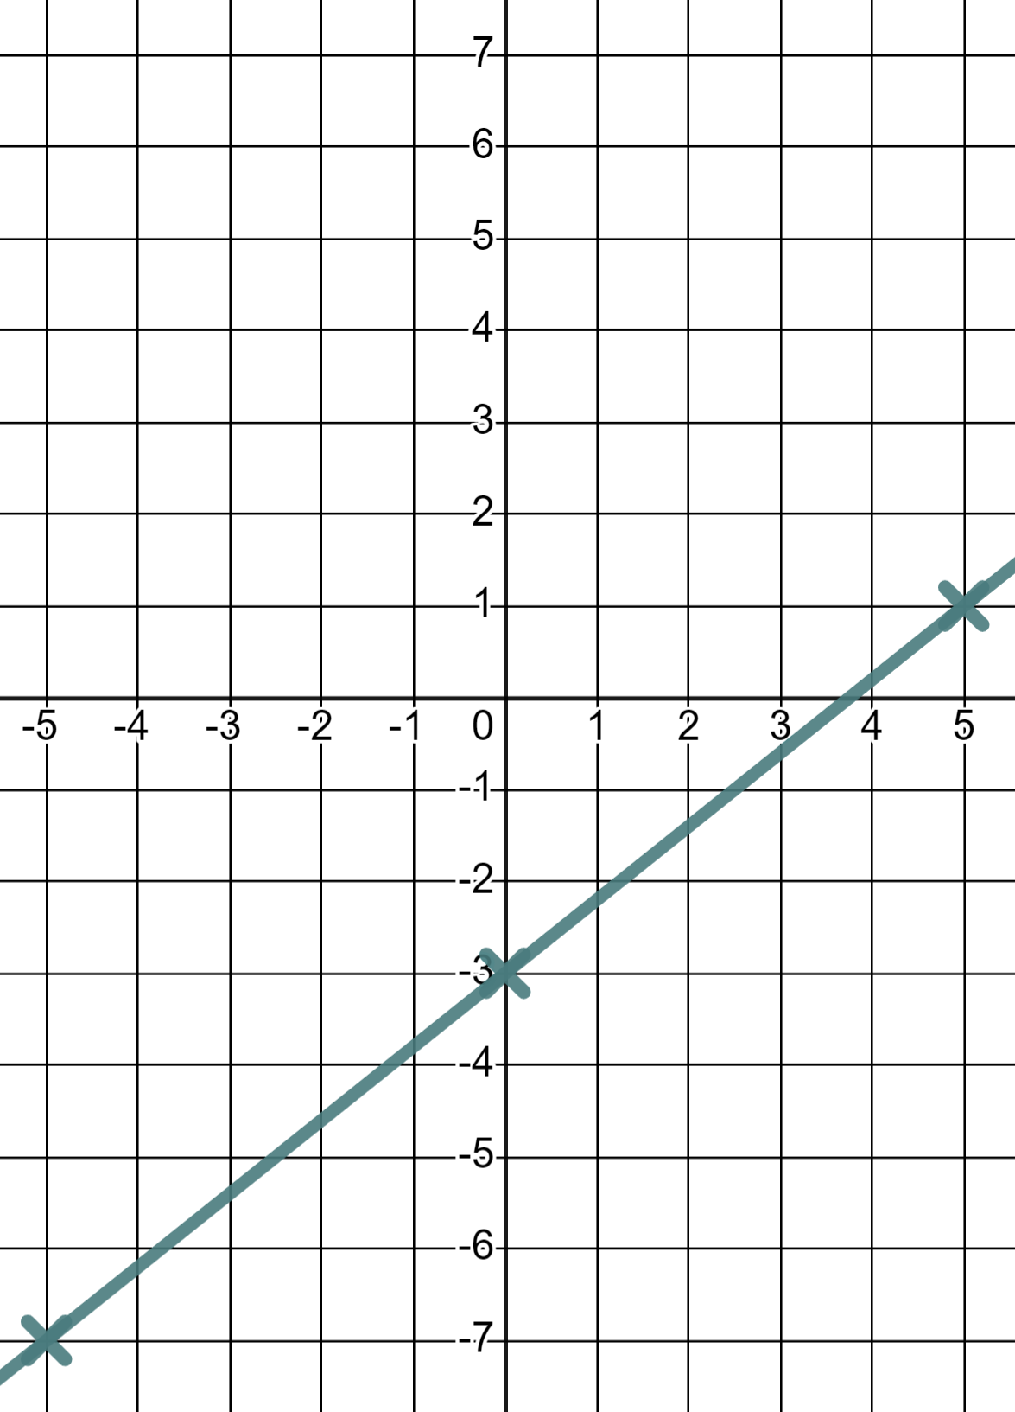
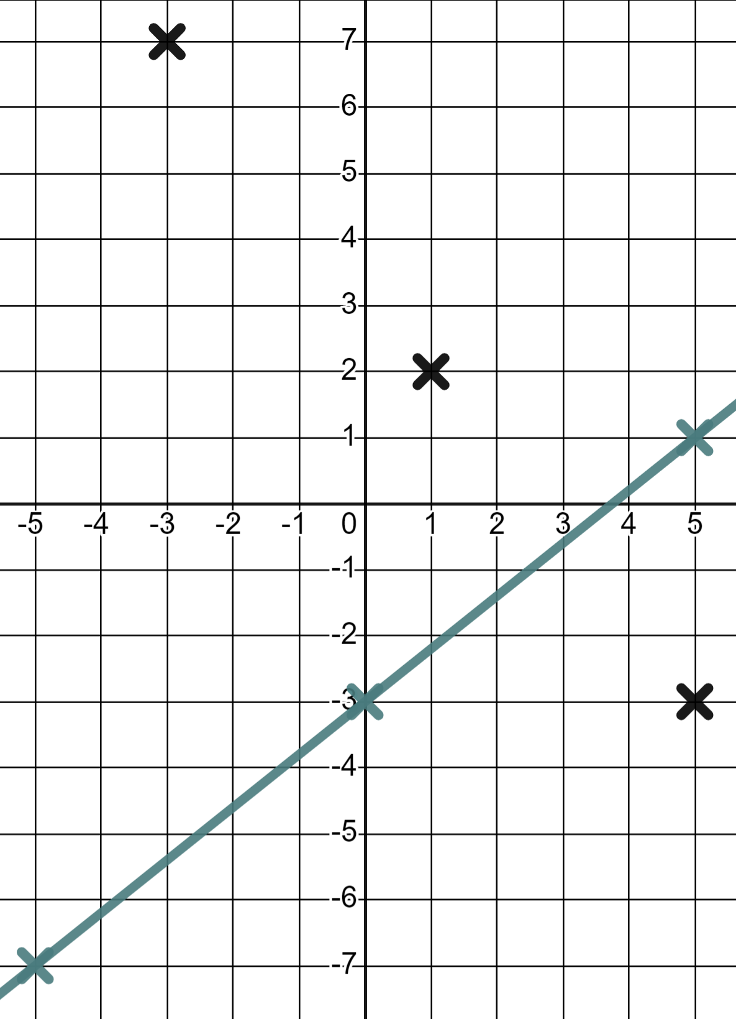
Efficiently drawing linear graphs
Task B: Efficiency in plotting
1) Find the coordinates for when x = 0 and when y = 0 thus draw the linear equations.
a) 3x + 2y = 6
b) 3x − 2y = 6
When x = 0
When x = 0
(0, 3)
(0, −3)
When y = 0
When y = 0
(2, 0)
(2, 0)
c) 9x + 3y = 27
d) 3y − 9x = 27
When x = 0
When x = 0
(0, 9)
(0, 9)
When y = 0
When y = 0
(3, 0)
(−3, 0)
2) For each graph find two x-values that will give you integer y-values and draw the linear equations.
a) y = 0.8x − 3
(0, −3)
(−5, −7)
(5, 1)
Then because 0.8, 1.6, 2.4, 3.2, 4, …you know you’ll hit another integer for every change of 5 in x
b) y = 3.25 − 1.25x
(1, 2)
(5, −3)
(−3, 7)
Then because 1.25, 2.5, 3.75, 5, …you know you’ll hit another integer for every change of 4 in x
Mathematics in Education and Industry
v2.3

